Slide 1

Harnessing National Science Foundation Resources and Grants for Advanced Research and Cyberinfrastructure
Amy Apon, PhD, Program Director
National Science Foundation
Computer Information Systems and Engineering Directorate
Office of Advanced Cyberinfrastructure

Slide 2
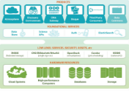







NSF Office of Advanced Cyberinfrastructure (OAC)
Compute, data, software, networking and people to facilitate scientific discovery and innovation
Observation
People, organizations,
and communities
Coordination
& User support
Gateways, Hubs,
and Services
Data Infrastructure
Software and
Workflow Systems
CI-Enabled
Instrumentation
Pilots,
Testbeds
Cloud Resources & Services
Discovery
Computing
Resources
R&E Networks,
Security Layers

Slide 3
Overview of topics today
Part 1: Brief Overview of NSF CI Resources and Services, including the NAIRR
Part 2: Funding for Research Infrastructure
Part 3: Interactive Q&A
Notes:
Questions are good; pauses for Qs built in after each part

Slide 4
NSF-supported Advanced CI Resources
Learn how to access resources at access-ci.org
Leadership-class
Frontera | U of Texas, Austin
Capacity Systems
Anvil | Purdue University
Bridges 2 | Carnegie-Mellon University
Delta | U of Illinois, Urbana-Champaign
Expanse | U of California, San Diego
Jetstream 2 | University of Indiana + Partners
Stampede 2 | U of Texas, Austin
Innovative Prototypes/Testbeds
Neocortex | Carnegie-Mellon University
Voyager | U of California, San Diego
Ookami | Stonybrook University
NRP | U of California, San Diego
ACES | Texas A&M University
Cloud resources
Cloudbank | U of California, San Diego
CloudLab | University of Utah
Chameleon | University of Chicago
Distributed Services
PATh/OSG | U of Wisconsin, Madison
ACCESS | Several Partners

Slide 5
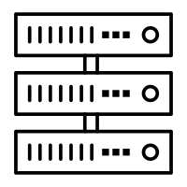








Vision for the National AI Research Resource
A widely-accessible, national research infrastructure that will advance the U.S. AI R&D environment, discovery, and innovation by empowering a diverse set of users through access to:
Secure, high-performance, privacy-preserving computing
  High-quality datasets
Catalogs of testbeds and educational materials
Training tools and user support mechanisms
Goals:
Spur innovation
Increase the diversity of talent in AI
Improve U.S. capacity for AI R&D
Advance trustworthy AI
5
Notes:
A widely-accessible, national cyberinfrastructure that will advance and accelerate the U.S. AI R&D environment and fuel AI discovery and innovation in the United States by empowering a diverse set of users across a range of fields through access to:

Slide 6



NAIRR Pilot launched 24Jan24!
11 Federal agencies contributing resources
25 industry & non-profit partners
Pilot will initially support:
  AI research to advance safe, secure, & trustworthy
  Application of AI to challenges in healthcare
  Environmental and infrastructure sustainability
  Infrastructure support to educators to enable training AI technologies & responsible approaches
The NAIRR pilot welcomes additional private sector and nonprofit partners. Those interested are encouraged to reach out to NSF at nairr_pilot@nsf.gov.
Research community members interested in hearing updates can subscribe to by signing up for announcements by emailing: NAIRR_PILOT_ANNOUNCEMENTS-subscribe-request@listserv.nsf.gov
NAIRR Pilot NSF Info Page
  Available at: https://bit.ly/4bedykr
  Includes information about Agency and Private Sector Contributions
NAIRR Pilot Portal
  Available at: nairrpilot.org
  Survey on Researcher and Educator Use Cases for the NAIRR Open through March 8
  Initial Call for access to advanced research computing Open through March 1
  Future calls will follow soon after!
  Available pilot for AI-related resources contributed by partners, such as AI ready datasets, pre-trained models, analytic platforms and software.

Slide 7





Incomplete Summary of CI resources and services for the research community
Democratized access to advanced computing
Advanced Computing Resources
Leadership-Class Computing Facility (LCCF) advancing to FDR and construction
National Artificial Intelligence Research Resource (NAIRR) pilot moving forward in FY24
High Throughput Computing
Science Gateways expertise
Portals: | ACCESS: https://access-ci.org/ LCCF: https://lccf.tacc.utexas.edu/ PaTh: https://path-cc.io/ SGX3: https://sciencegateways.org/ MSCC: https://www.ms-cc.org/ RCD Nexus: https://rcd-nexus.org/ CaRCC: https://carcc.org/ Trusted CI: https://www.trustedci.org/ Research SOC: https://omnisoc.iu.edu/services/researchsoc/ CI Compass: https://ci-compass.org/
Community and workforce development
Minority Serving CI Consortium (MS-CC)
CyberTraining & SCIPE
CI Workforce Development
Notes:
Advanced computing resources
Leadership-Class Computing Facility (LCCF) advancing to FDR and construction.
ACCESS: Follow-on to XSEDE, started operations for the fabric of services.
PaTh credits: High-throughput computing credits for NSF awards..
CI Centers of Excellence (CI CoEs)
SGX3. Community services for creating and operating Science Gateways (follow-on to SGCI).
MS-CC Pilot. Minority Serving – CI Consortium, to accelerate CI research capacity at HBCUs and TCUs.
RCD Nexus Pilot: Research Computing and Data Resource and Career Center.

Slide 8
Part 2: Funding for Research Cyberinfrastructure
Notes:
Questions are good; pauses for Qs built in after each part

Slide 9
Advanced Cyberinfrastructure
Funding Opportunities
Advanced Computing
Networking & Cybersecurity
Learning & Workforce Development
National research workforce for creating, utilizing, supporting advanced CI: SCIPE, CyberTraining
Software & Data CI
Strategic
Investments
Supports development and deployment of robust, reliable, sustainable data and software CI
Special opportunities, cross-cutting and national initiatives, CI for open science and public access
Advanced networking and security infrastructure, research and communities of practice capabilities
Production and operational level advanced computing and data capabilities and services
Notes:
Integration theme

Slide 10





A Sketch of NSF and CISE Infrastructure Programs (for things)
National
Community
Individual
& Institutional
100M
Solicitation 21-537
20M
Infrastructure “things” include Hardware, Data and Software at scale
10M
Size $
*$$ Not at scale
Solicitation 21-065
5M
1M
Cyber-infrastructure
for Sustained Scientific
Innovation (CSSI)
Elements
Campus Cyber-infrastructure
Major
Research Instrumentation
CSSI
Frameworks
CISE Community Research Infrastructure
Advanced
Computing
Systems &
Services
Mid-scale Research
Infrastructure 1
Mid-scale Research
Infrastructure 2

Slide 11
Campus Cyberinfrastructure (CC*)
Must be science driven
Must have a campus Cyberinfrastructure Plan (except Strategy awards)
Seek to create partnerships – researchers, educators, IT organization
Networking & Cybersecurity
Area 1: Data Driven Networking Infrastructure
Campus up to $700K
Region up to $1.4M
Technical solution; network management plan and diagram; leverage community
Area 2: Computing and the Computing Continuum
Campus up to $700K
Region up to $1.4M
Multiple science drivers and needs; architecture; 20% is shared, typically through PATh
Area 3: Network Integration and Applied Innovation
Small up to $500K
Large up to $1M
Networking R&D applied to the campus network with graduate student involvement
Area 4: Data Storage and Digital Archives
Campus up to $700K
Region up to $1.4M
Multiple science drivers and needs; architecture; 20% is shared, typically through OSDF
Area 5: Strategy
Campus up to $100K
Region up to $200K
A grant to help teams plan for a full proposal!
No CI plan; Funds community building activities; No hardware
See NSF 24-530 for details. Deadlines are April 22 and October 15, 2024.
Program Officers: Amy Apon, awapon@nsf.gov and Kevin Thompson, kthompso@nsf.gov

Slide 12
Campus Cyberinfrastructure (CC*)
NSF 24-530
Networking & Cybersecurity
Must be science driven
Must have a campus Cyberinfrastructure Plan (except Area 5)
Must have vendor quotes for Areas 1, 2, and 4
Seek to create partnerships – researchers, educators, IT organization
Proposals for the Campus must address campus-wide needs, not a single research project.
Proposals for the Region must address needs of multiple small or under resourced institutions.
  These can be led by a regional research lead organization!
New this year: For Areas 1, 2, and 4, at least 50% of the budget must go to funding hardware in that area – leaving 50% for you to allocate to staff, other hardware, community engagement, etc. All costs must be justified.

Slide 13
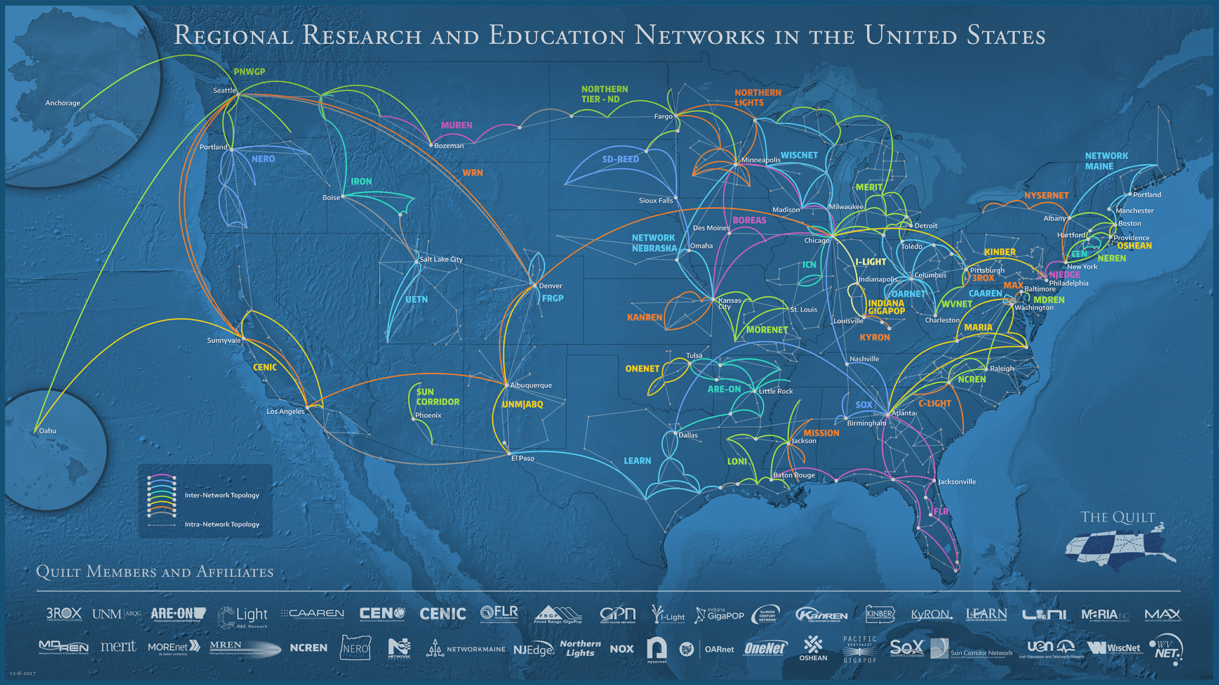
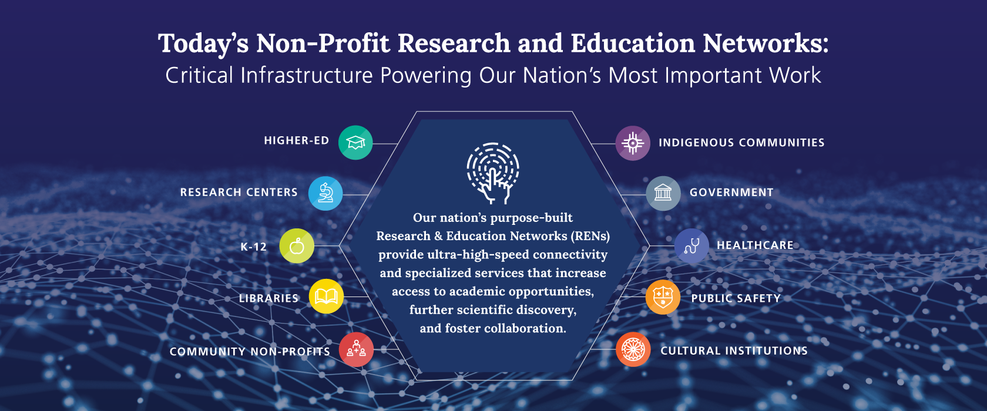
CC* Area 1 supports Campus Connection to Research and Education Networks

Slide 14
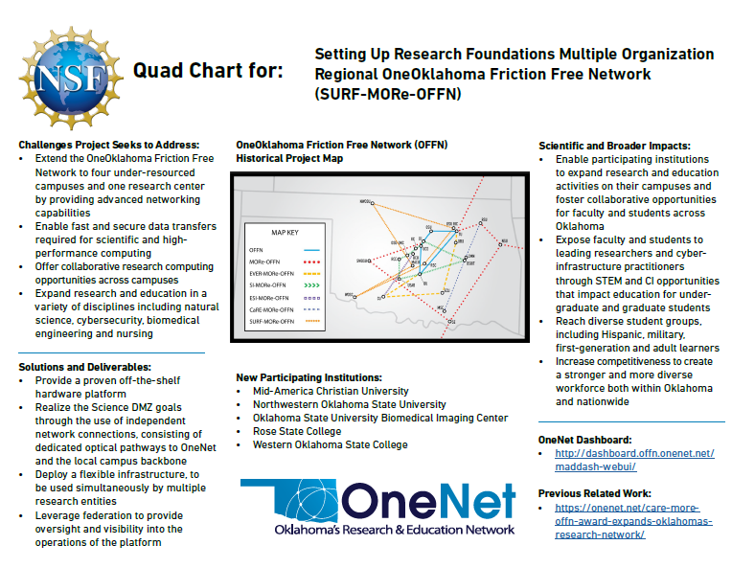

Slide 15
Campus Cyberinfrastructure (CC*)
Outline that could lead to a competitive proposal
Overview of the project, about one page
Why are you doing this?
  What science will benefit, and how?
  Include details, demonstrate partnership with the researchers and the IT organization, include a summary table of science drivers
  About 6 pages
What technology do you want to build/upgrade?
  Include a network diagram showing current status and proposed upgrade
  Include parts, description of capabilities with numbers, refer to vendor quotes
  About 2 pages
Who will build it? Include names and expertise of staff/personnel. About one page
  If not the PI, include a letter from someone with authority to commit the resources
Provide a project plan with objectives and a timeline – about three pages
Describe the dissemination plan and metrics you will collect – about page
Provide a network management plan and partnership overview – about one page
Provide a sustainability plan for what happens after the project completes, especially for staff – include letters from someone with authority
Results from prior NSF funding required

Slide 16
Campus Cyberinfrastructure (CC*)
NSF 24-530
Networking & Cybersecurity
Read the solicitation carefully.
For Areas 1, 2, and 4 solicitation specific criteria are:
  The extent to which science drivers and applications motivate the types of resources requested.
  The strength of the partnership among campus-level CI experts, including the campus Information Technology (IT)/networking/data organization, contributing domain scientists, research groups, and educators.
  Tangible metrics to measure the success of the system or set of activities.
  The strength of the project management plan addressing clear goals and milestones resulting in a working system in the target environment.
  How well the sustainability of the cyberinfrastructure is addressed.

Slide 17
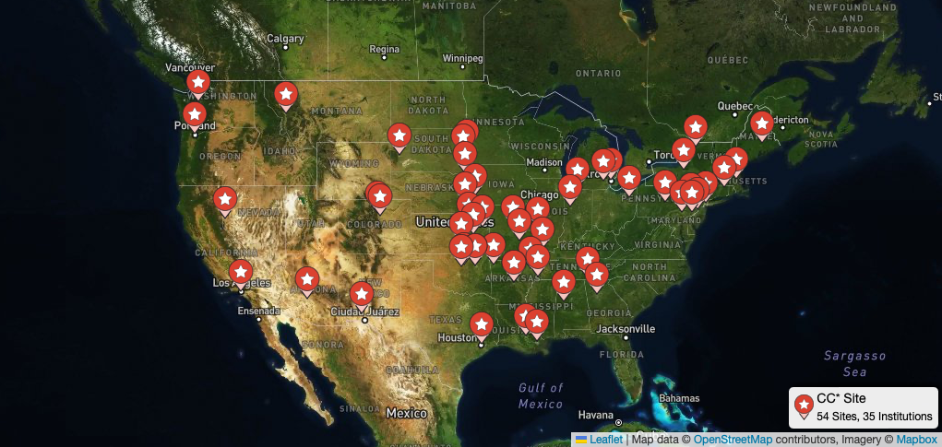

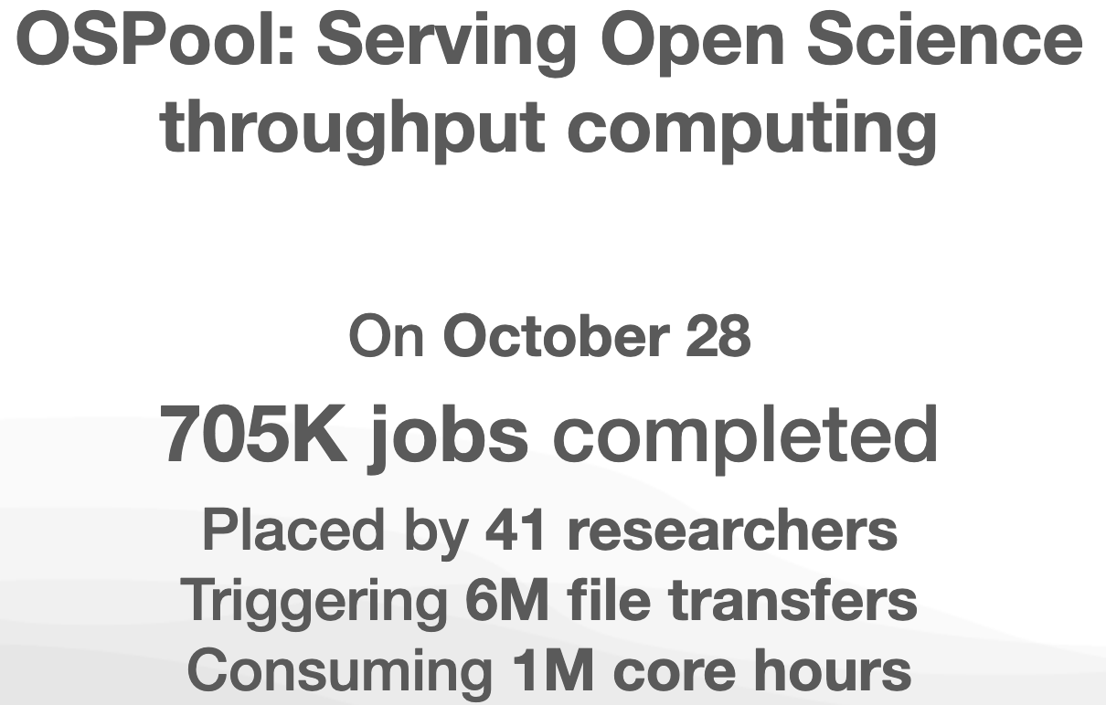
https://osg-htc.org/campus-cyberinfrastructure
Area 2: Computing and the Computing Continuum 20% is shared, typically through OSG
The OSG Fabric of Services connects over 150 sites across the US and internationally, making compute and data resources available through their Access Points.
In the last 12 months, over 2.6B CPU hours were delivered by OSG services

Slide 18
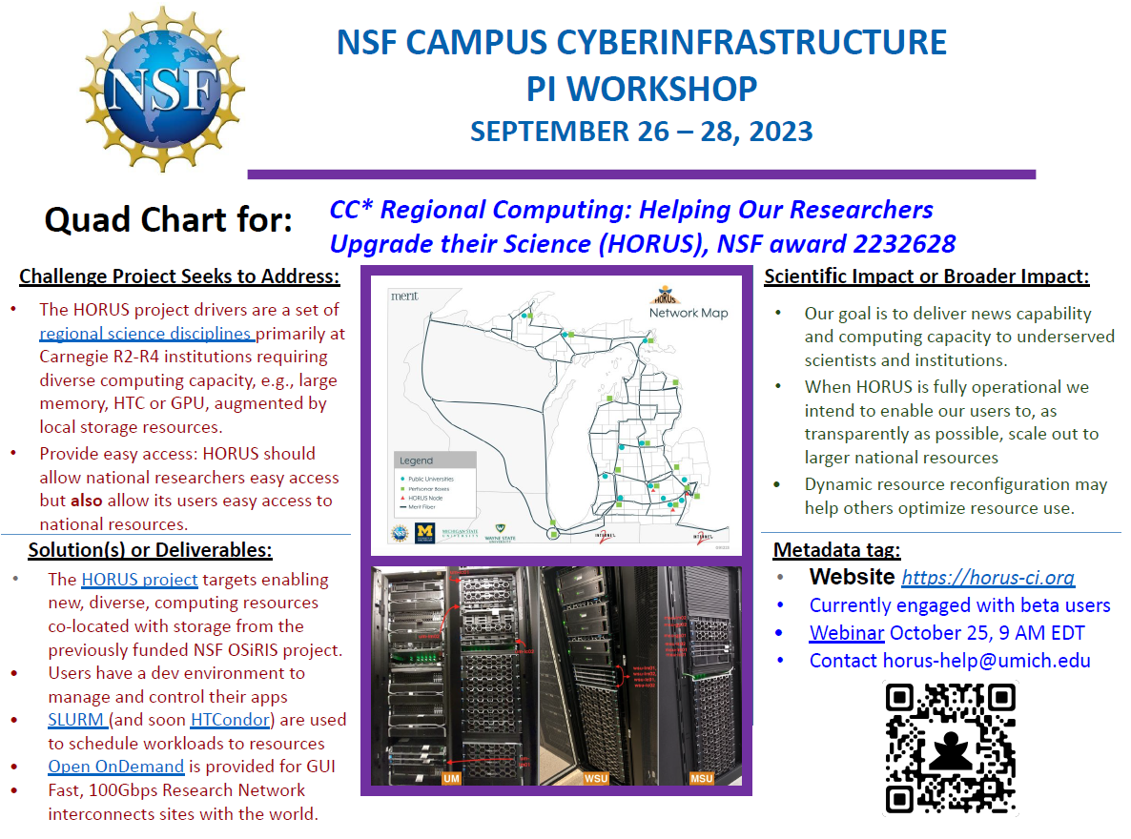

Slide 19
CC* Area 4: Data Storage and Digital Archives
New this year: Region awards for Data Storage and Digital Archives
Campus up to $700K, Region up to $1.4M
Must describe multiple science drivers and needs
Include an architecture diagram
20% is shared, typically through OSDF
Vendor quotes must be included
Funds for software licenses are not permitted

Slide 20
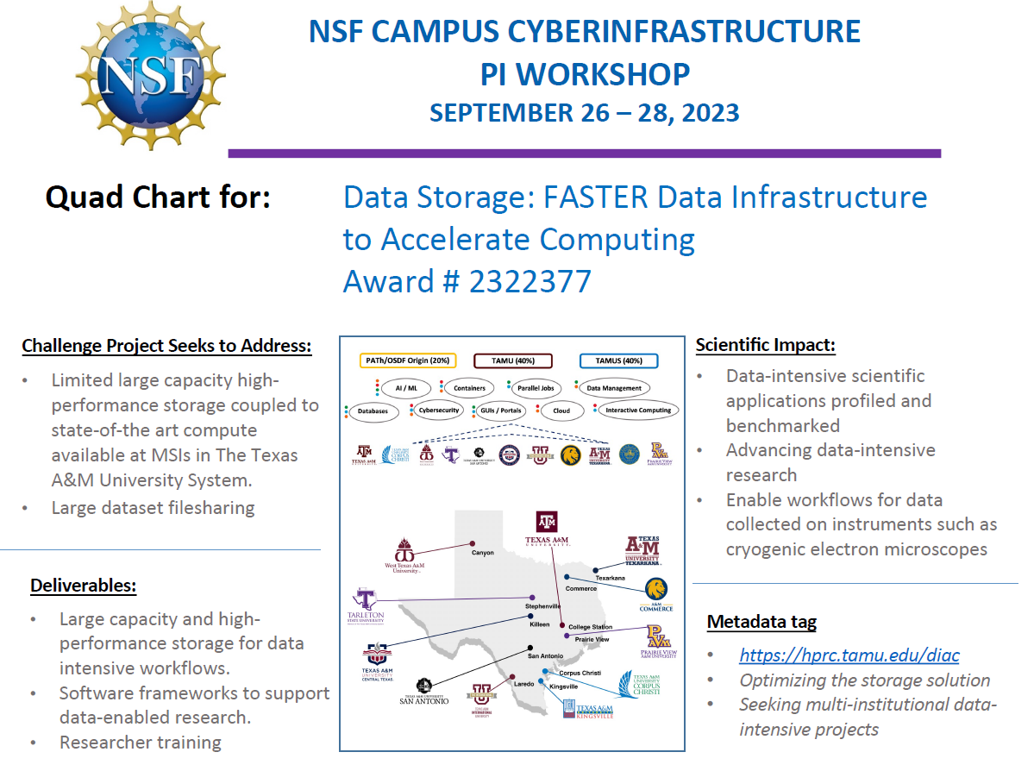

Slide 21
Major Research Instrumentation (MRI)
Advanced Computing
The NSF MRI Program serves to increase access to multi-user scientific and engineering instrumentation for research and research training.
Current Solicitation: NSF 23-519
Submission Window: October 15, 2024 - November 15, 2024
Two main categories: Acquisition & Development
Two budget tracks:
Track 1: $ 100,000 - $1,400,000
  Track 2: $1,400,000 - $4,000,000
NOTE: No cost-sharing (used to be required)
Program Officer: Al Suarez, alsuarez@nsf.gov
Notes:
NSF-wide program (including ENG) Part of NSF’s broader Research Infrastructure Portfolio
Emphasis has been provided to indicate that the MRI Program seeks broad representation by PIs in its award portfolio, including women, underrepresented minorities and persons with disabilities. Since diversity may be greater among early-career researchers, the MRI program also encourages proposals with early-career PIs and proposals that benefit early-career researchers.
While I have no NSF guidance to share, you may wish to look at the CHIPS and Science act that was just passed, as it references Major Research Instrumentation

Slide 22
Q&A
Amy Apon, awapon@nsf.gov
Kevin Thompson, kthompso@nsf.gov

Slide 23


Slide 24
Extra Slides
Notes:
Questions are good; pauses for Qs built in after each part

Slide 25
Training-based Workforce Development for Advanced Cyberinfrastructure (CyberTraining)
Learning & Workforce
Long-term vision: Prepare, nurture, and grow the scientific research workforce, including students, instructors, and research CI professionals
Ensure broad adoption of CI tools, methods, and resources
Integrate CI and CDS&E skills into undergraduate and graduate curricula
  Innovative and scalable training, and catalyze research with training and education
Broaden CI access and adoption by varied institutions, scientific communities, and underrepresented groups.
Three levels: Pilot, Small, and Medium
NSF 23-520, deadline is the third Thursday in January each year.
Program officers: Ashok Srinivasan asrinva@nsf.gov, Juan (Jennry) Li jjli@nsf.gov
Notes:
We now discuss the program goals.
The CyberTraining program seeks to prepare, nurture, and grow the national scientific research workforce for creating, utilizing, and supporting advanced cyberinfrastructure to enable and potentially transform fundamental science and engineering research and contribute to the nation's overall economic competitiveness and security.
The projects should aim to contribute to the larger goal of an educational ecosystem enabling “Computational and Data-driven Science for All scientists and Engineers”
This embraces computation as the third pillar and data-driven science as the fourth pillar of the scientific discovery process -- in addition to the traditional first and second pillars of theory and experimentation.
The specific goals of this solicitation are
(i) to ensure broad adoption of CI tools, methods, and resources by the research community in order to catalyze major research advances; and
(ii) to integrate core literacy and discipline-appropriate advanced skills in advanced CI as well as computational and data-driven science and engineering into the nation’s educational curriculum and instructional fabric, spanning both undergraduate and graduate courses to advance fundamental research.
We are particularly keen on broadening CI access to groups that are currently underserved in its use.
This solicitation calls for innovative and scalable training, education, and curriculum and instructional materials - targeting one or both of the solicitation goals - to address emerging needs and unresolved bottlenecks in scientific and engineering research workforce development, from the postsecondary level up to the level of active researchers.

Slide 26
Strengthening the Cyberinfrastructure Professionals Ecosystem (SCIPE)
Learning & Workforce
FUNDING
Cyberinfrastructure Professionals
IDEAL FOR PIs WHO …
Are ready to connect & coordinate with national S&E research communities
Whose institutions will develop sustainable long-term career paths for CIPs
Approximately $15M for up to 4 awards
Support for research CI professionals’ services
Develop, manage, and support effective use of CI
System administrators, research staff, software engineers, data curators, CI facilitators, …
NSF 23-521 Deadline is third Thursday in January each year.
Notes:
The level of funding, as always depends on availability. And as always, serving multiple Directorates creates the possibility of recruiting co-funding.
Please note SCIPE is about deploying and maintaining readiness of CI Professional SERVICES – as contrasted with CyberTraining tools or curricula or student development
Funding considerations will include assessment of your proposed approach to funding the CIP positions post-award.
Proposals are welcome to focus on any one, or more, of the unique facings of CIP. Again, the selected foci should be science-driven.
The ideal proposals are framed in part by the 6 criteria listed online.
Broadening Adoption of Advanced CI infrastructure and methods;
Integration with the Computational Science Support Network (CSSN);
Overcoming Challenges to recognizing and democratizing research CIP workforce development;
Building scalable and sustainable communities of CIP;
Recruitment and evaluation; and
"Collective Impact" Strategy: Coordination elements that comprise a network and Backbone organization (or an alternative strategy).

